Slide 1

Introduction to PsychToolbox in MATLAB
Psych 599, Summer 2013
Jonas Kaplan, Ph.D.
University of Southern California
Week 3

Slide 2
Week 2 Recap

Slide 3
Finding values within a matrix
>> x = rand(1,5)
x =
Columns 1 through 8
0.7060 0.0318 0.2769 0.0462 0.0971 0.8235 0.6948 0.3171
Columns 9 through 10
0.9502 0.0344
>> find(x>.5)
ans =
1 6 7 9

Slide 4
Logical indexing
>> x>.5
ans =
1 0 0 0 0 1 1 0 1 0
>> vec = ans;
>> whos vec
Name Size Bytes Class Attributes
vec 1x10 10 logical
>> x(vec)
ans =
0.7060 0.8235 0.6948 0.9502
>> x(x>.5)
ans =
0.7060 0.8235 0.6948 0.9502
equivalent to
x(find(x>.5))

Slide 5
Getting the truth
== equal to (distinguish from = which sets a value)
~= not equal to
> greater than
< less than
>= greater than or equal to
<= less than or equal to

Slide 6
Testing the truth
Logical operators:
& AND (sometimes you will see &&)
| OR (sometimes you will see ||)
~ NOT

Slide 7
>> x = 5; y = 1;
>> x > 4 & y > 4
ans =
0
>> (x>4) & (y>4)
ans =
0
>> (x>4) | (y>4)
ans =
1
>> (y>4)
ans =
0
>> ~(y>4)
ans =
1

Slide 8
Comparing strings
>> x = 'hello';
>> y= 'goodbye';
>> x == y
Error using ==
Matrix dimensions must agree.
>> help strcmp
strcmp Compare strings.
TF = strcmp(S1,S2) compares the strings S1 and S2 and returns logical 1
(true) if they are identical, and returns logical 0 (false) otherwise.
>> strcmp(x,y)
ans =
0
>> y = ‘Hello’;
>> strcmp(x,y)
ans =
0
>> strcmpi(x,y)
ans =
1

Slide 9
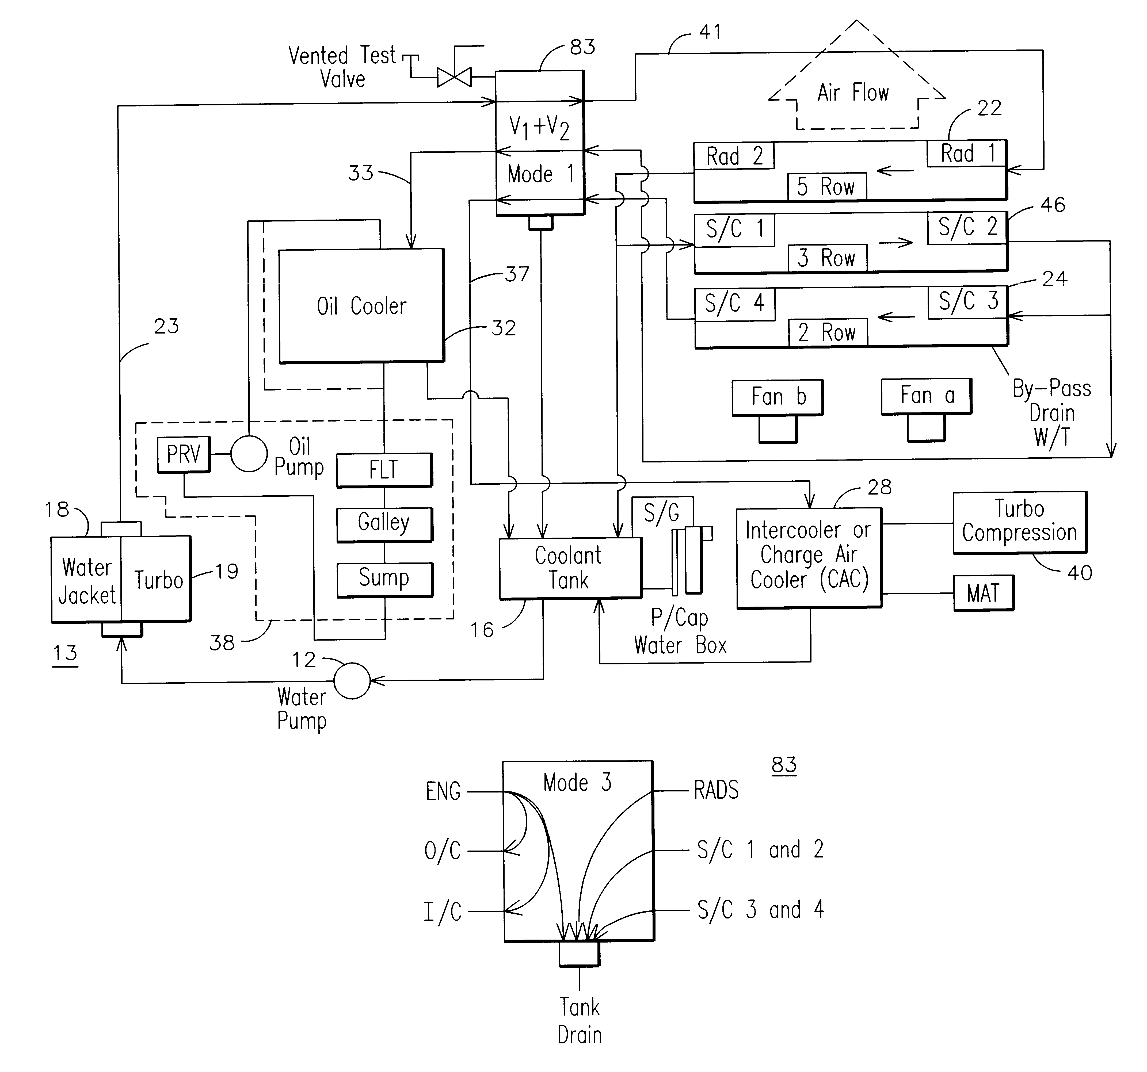
Flow control

Slide 10
Conditionals
if condition
do this stuff
end
if condition
do this stuff
else
do this stuff
end
if condition
do this stuff
elseif condition
do this stuff
else
do this stuff
end

Slide 11
For loops
counter variable
function doLoop()
%do a loop
for i = 1:10
j = sqrt(i);
fprintf(‘The square root of %d is: %.2f\n’,i,j);
end
range of values for counter to take on
code to be repeated
>> doLoop()
The square root of 1 is 1.00
The square root of 2 is 1.41
The square root of 3 is 1.73
The square root of 4 is 2.00
The square root of 5 is 2.24
The square root of 6 is 2.45
The square root of 7 is 2.65
The square root of 8 is 2.83
The square root of 9 is 3.00
The square root of 10 is 3.16

Slide 12
While loops
while condition
do this stuff
end

Slide 13
Opening files
Permission codes
‘r’ open file for reading
‘w’ open file for writing (will create or overwrite)
‘a’ append data to file (will create if doesn’t already exist)

Slide 14
Working with files
Introducing fopen() and fclose()
General plan for working with files:
fopen()
<read from file or write to file>
fclose()

Slide 15
Opening files
number returned by fopen which you will use to refer to this file
fid = fopen(filename, permission)
string with name of file or full path to file if it’s not in the current directory
string containing code that determines what Matlab is allowed to do with this file

Slide 16
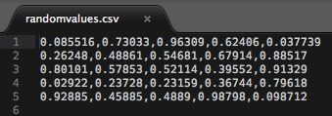
Writing to files
>> x = rand(5)
x =
0.0855 0.7303 0.9631 0.6241 0.0377
0.2625 0.4886 0.5468 0.6791 0.8852
0.8010 0.5785 0.5211 0.3955 0.9133
0.0292 0.2373 0.2316 0.3674 0.7962
0.9289 0.4588 0.4889 0.9880 0.0987
>> csvwrite('randomvalues.csv',x)
>> clear all
>> x = csvread('randomvalues.csv')
x =
0.0855 0.7303 0.9631 0.6241 0.0377
0.2625 0.4886 0.5468 0.6791 0.8852
0.8010 0.5785 0.5211 0.3955 0.9133
0.0292 0.2373 0.2316 0.3674 0.7962
0.9288 0.4588 0.4889 0.9880 0.0987

Slide 17
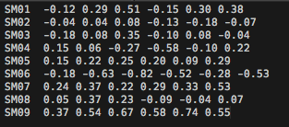
Reading from text files
Contents of "log.txt":
>> logFID = fopen('log.txt');
>> data = textascan(logFID,'%s %f %f %f %f %f %f')
data =
Columns 1 through 5
{9x1 cell} [9x1 double] [9x1 double] [9x1 double] [9x1 double]
Columns 6 through 7
[9x1 double] [9x1 double]

Slide 18
Testing your PTB installation
>> PsychtoolboxVersion
ans =
3.0.11 - Flavor: beta - Corresponds to SVN Revision 4030 but is *locally modified* !
For more info visit:
https://github.com/Psychtoolbox-3/Psychtoolbox-3
>> UpdatePsychtoolbox
>>
>> help PsychDemos
>>
>> KbDemo

Slide 19
The Screen command
>> Screen
Usage:
% Activate compatibility mode: Try to behave like the old MacOS-9 Psychtoolbox:
oldEnableFlag=Screen('Preference', 'EmulateOldPTB', [enableFlag]);
% Open or close a window or texture:
[windowPtr,rect]=Screen('OpenWindow',windowPtrOrScreenNumber [,color] [,rect] [,pixelSize] [,numberOfBuffers] [,stereomode] [,multisample][,imagingmode][,specialFlags][,clientRect]);
[windowPtr,rect]=Screen('OpenOffscreenWindow',windowPtrOrScreenNumber [,color] [,rect] [,pixelSize] [,specialFlags] [,multiSample]);
textureIndex=Screen('MakeTexture', WindowIndex, imageMatrix [, optimizeForDrawAngle=0] [, specialFlags=0] [, floatprecision=0] [, textureOrientation=0] [, textureShader=0]);
oldParams = Screen('PanelFitter', windowPtr [, newParams]);
Screen('Close', [windowOrTextureIndex or list of textureIndices/offscreenWindowIndices]);
Screen('CloseAll');
% Draw lines and solids like QuickDraw and DirectX (OS 9 and Windows):
currentbuffer = Screen('SelectStereoDrawBuffer', windowPtr [, bufferid] [, param1]);
Screen('DrawLine', windowPtr [,color], fromH, fromV, toH, toV [,penWidth]);
Screen('DrawArc',windowPtr,[color],[rect],startAngle,arcAngle)
Screen('FrameArc',windowPtr,[color],[rect],startAngle,arcAngle[,penWidth] [,penHeight] [,penMode])
Screen('FillArc',windowPtr,[color],[rect],startAngle,arcAngle)
Screen('FillRect', windowPtr [,color] [,rect] );
Screen('FrameRect', windowPtr [,color] [,rect] [,penWidth]);
Screen('FillOval', windowPtr [,color] [,rect] [,perfectUpToMaxDiameter]);
Screen('FrameOval', windowPtr [,color] [,rect] [,penWidth] [,penHeight] [,penMode]);
Screen('FramePoly', windowPtr [,color], pointList [,penWidth]);

Slide 20
Double buffering
Note that flipping clears the new back buffer
A
"Back" screen/buffer
Swap or "Flip"
buffers
"Front" screen/buffer

Slide 21
Using the Screen command
Opening the screen
[windowPtr,rect]=Screen('OpenWindow',ScreenNumber)
returns a number that we will use to refer to this screen in future commands
which screen you want to open (you may have multiple monitors)
returns a rectangle (a vector of four numbers) that describe the dimensions of the screen

Slide 22
[windowPtr,rect]=Screen('OpenWindow',ScreenNumber)
returns a rectangle (a vector of four numbers) that describe the dimensions of the screen
>> rect
rect =
0 0 1680 1050
width
height
(0,0)
x
y
(1680,1050)

Slide 23
NEW
Understanding rects
>> rect
rect =
0 0 1680 1050
x1
y1
x2
y2
left
top
right
bottom
(x1,y1)
x
y
(x2,y2)

Slide 25
Assignment Week 2
Write a function called yourInitials_week2()
The function should take one input:
1) a string specifying a subject’s code.
The function should do the following:
1) read in exercise.txt. Exercise.txt has four columns that correspond to: subject, condition, iterations, and score.
2) Report the subject chosen and the corresponding score of that specific subject to the command window.
3) Perform a loop that iterates the number of times in the iterations column of the chosen subject’s row. Each time through the loop, the subject’s score will either double or triple, depending on column 2 (subjects with a ‘D’ are in the double condition; subjects with a ‘T’ are in the triple condition).
4) Print out that score each iteration, both to the Command Window and to a file called “output.txt”

Slide 26
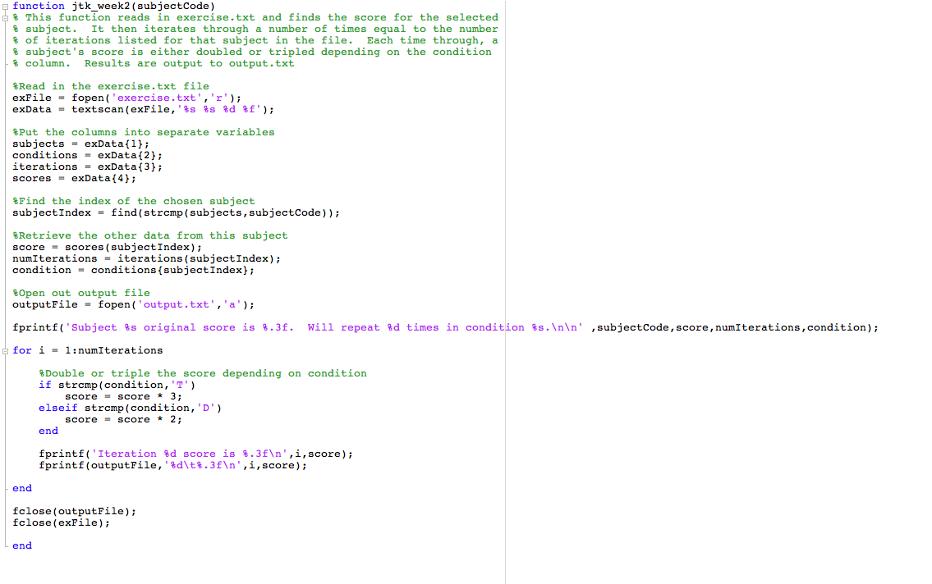

Slide 27
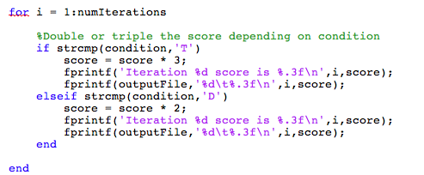
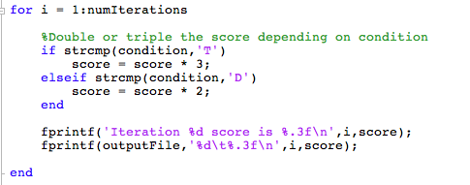

Slide 28
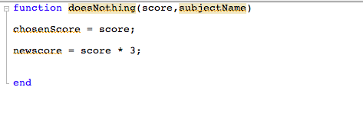
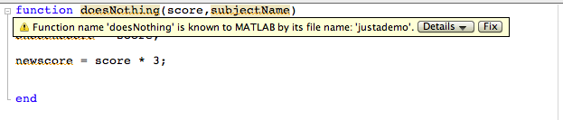
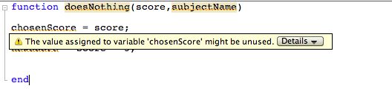

Slide 29
Week 3
Debugging
How monitors work
Screen timing
Understanding color
Drawing basic shapes
Alpha transparency
Drawing Text
Animation
Presenting images

Slide 30
Debugging
Matlab includes a built-in debugging tool to help you diagnose errors in your code

Slide 31
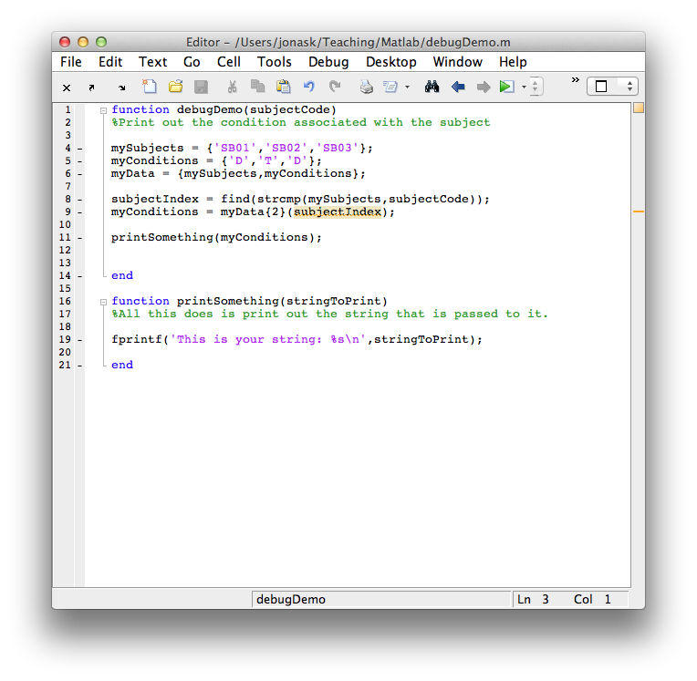
NOTE: We are calling another function that we defined in the same file.
In a script, we can call functions that are:
built-in Matlab functions
defined within the same file
in other files in the same folder
in other files in folders that are in the PATH

Slide 32
Debugging
proximal cause of error
>> debugDemo('SB02')
Error using fprintf
Function is not defined for 'cell' inputs.
Error in debugDemo>printSomething (line 19)
fprintf('This is your string: %s\n',stringToPrint);
Error in debugDemo (line 11)
printSomething(myConditions);
distal cause of error
Links to the help file for that function
Links to the line in the script where the problem occurred

Slide 33
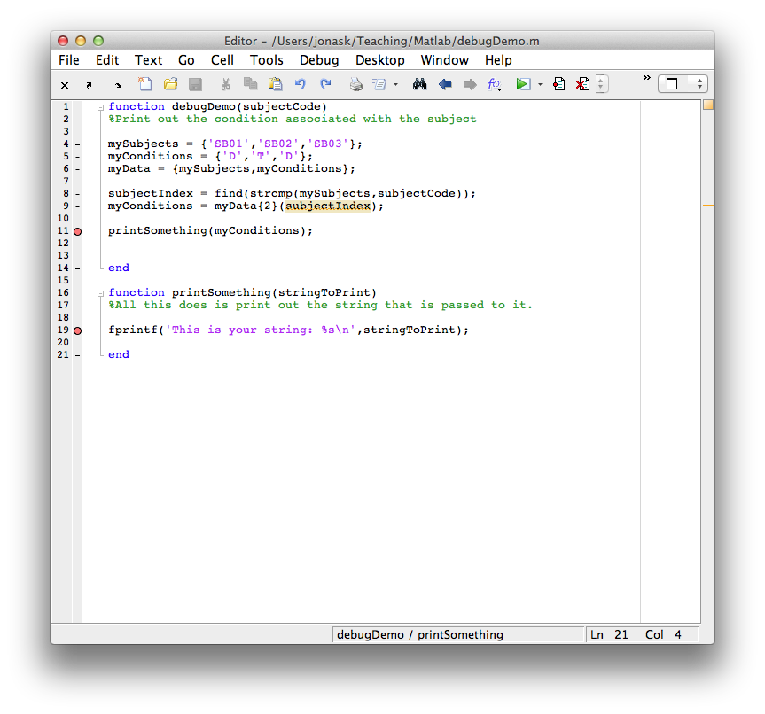
BREAKPOINTS

Slide 34
Debugging
>> debugDemo('SB02')
>> debugDemo('SB02')
11 printSomething(myConditions);
K>>
K>> prompt indicates that are are in debug mode
This is the line where the script has paused (we set a breakpoint here). The line number is a link to the line in the editor.
Workspace shifts to showing all the variables in memory inside the function

Slide 35
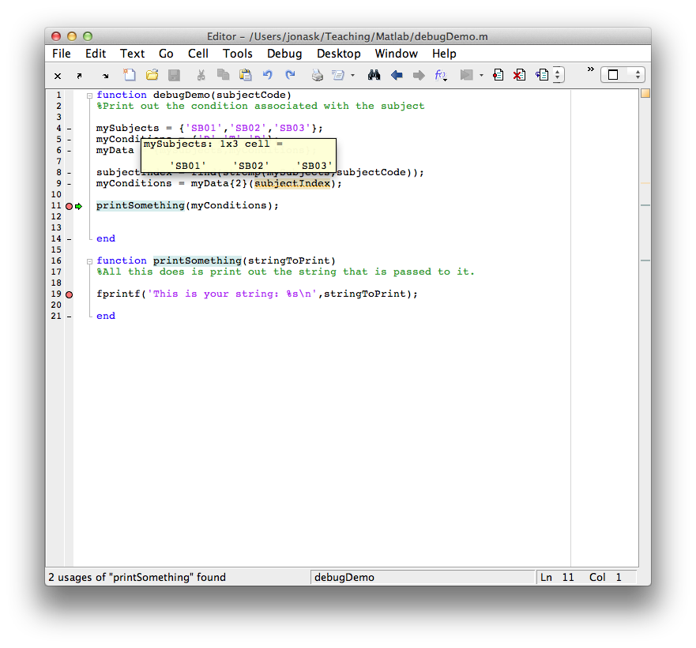
GREEN ARROW SHOWS WHERE WE ARE PAUSED

Slide 37
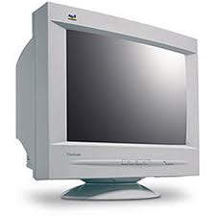
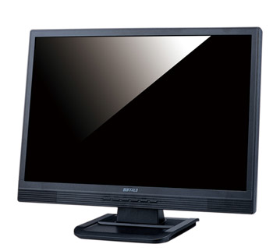
How monitors work
CRT
(Cathode Ray Tube)
LCD
(Liquid Crystal Display)

Slide 38
How monitors work
Frame Rate: The number of frames drawn per second
A
A
A
A
A
A
A
A
A
TIME
Typical frame rate: 60Hz (60 frames per second)
1 second / 60 frames == 16.67 milliseconds per frame

Slide 39
How monitors work
Frame Rate
Puts limits on the precision of our visual presentation
Cannot present something for shorter than the length of a single frame
Screen refresh timing is the anchor that PTB uses for all timing measurement
A
A
A
A
A
A
A
A
A
TIME

Slide 40
How monitors work
Getting your frame duration in PTB
A
A
A
A
A
A
A
A
A
frameDuration = Screen('GetFlipInterval',windowPtr)
TIME

Slide 41
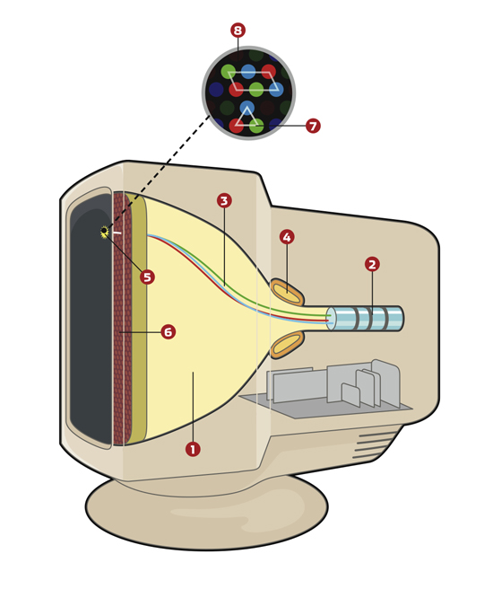
How monitors work
1 – cathode ray tube
2 – electron gun
3 – electron beam
4 – deflection yoke
The deflection yoke manipulates the electron beam, sweeping it across the screen, one horizontal line ("scanline") at a time

Slide 42
How monitors work
Once one frame is completely drawn, there is a gap in time as the beam is blanked and sweeps back to the first scanline to start drawing the next frame. This gap between frames is called the Vertical BLank interval (VBL).
The current position of the beam while it scans is called beamposition.

Slide 43
How monitors work
To maintain backwards compatibility, LCD's also implement a VBL even though they don't technically need one.
They also report a beamposition (the location of the current scanline), even though they don't use a beam.

Slide 44
TIME
Frame 1
Frame 2
Frame 3
Frame 4
VBL
VBL
VBL
PTB tries to swap the front and back buffers during the VBL, so that content is not being updated in the middle of a frame draw.
This is called VBL Synchronization. If synchronization between buffer-swapping and VBL fails:
- Visual artifacts like flicker and tearing may occur
- Timing measurement will be less precise

Slide 45
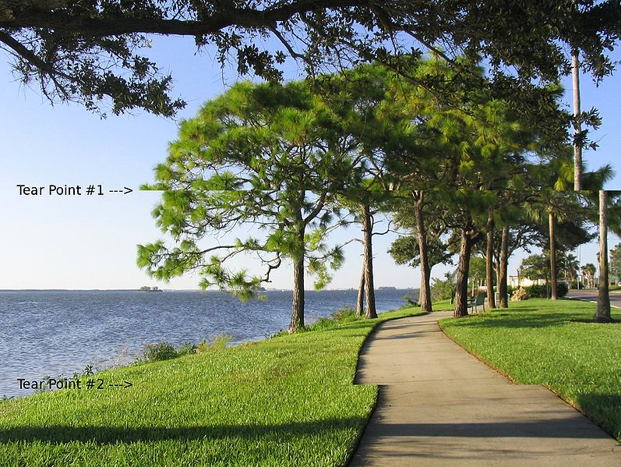
Tearing artifact

Slide 46
Testing the screen
When you run Screen('OpenWindow'), PTB will go through a series of Sync Tests and will report to you any issues. Read this information carefully and follow its advice.
The flashing triangle warning generally means Sync has failed
Several additional tools are available to test and diagnose screen sync issues:
ScreenTest()
VBLSyncTest()
PerceptualVBLSyncTest()

Slide 47
Testing the screen
If timing is important to you, and you are having VBL sync issues, try the following:
If you are using multiple monitors, match their resolutions and settings, or use mirror mode
Only use one monitor
On mac, make sure PsychtoolboxKernelDriver is installed
read help SyncTrouble for other tips and Platform-specific issues

Slide 48
Skipping Sync Tests
If Sync is not important to you, for instance you are debugging on a machine that you will not use for actual testing, you can disable the Sync test that is performed when you invoke OpenWindow:
Screen('Preference','SkipSyncTests',1);
(you can set this value back to 0 to re-enable SyncTests)

Slide 49
Screen Timing
flipTime = Screen('Flip',windowPtr)
>> wPtr = Screen('OpenWindow',1);
>> flipTime = Screen('Flip',wPtr);
flipTime =
1.1038e+05
>>

Slide 50
Screen Timing
GetSecs() tells you the current time
>> now = GetSecs()
now =
1.1058e+05
>> aLittleLater = GetSecs()
aLitterLater =
1.1060e+05
>> gap = aLittleLater – now
gap =
21.2212

Slide 51
Flip timing
VBLtime = Screen('Flip',windowPtr [, when] [,dontclear])
Default is to flip now, i.e. at the next VBL interval. However, you can specify a time in the future for the flip to take place. Flip will wait until that time and then flip at the next VBL interval after the specified time.
Default is to clear the back buffer. However in some cases you may want to leave the back buffer as is. Default is 0, set to 1 if you don't want it to clear.

Slide 52
Waiting
WaitSecs(s)
WaitSecs('UntilTime',when)
KbWait()

Slide 53
KbWait
[secs, keyCode, deltaSecs] = KbWait()
Will wait until the user presses a key, and return the time and keypress.
KbWait IS NOT FOR MEASURING
REACTION TIMES!!

Slide 54
KbWait
[secs, keyCode, deltaSecs] = KbWait()
keyCode is a vector of all the keys, with a 1 for any key that was pressed.
find(keyCode) will return the index of the button(s) pressed.
That code can then be turned into a character using KbName()

Slide 55
KbWait
>> WaitSecs(1);[secs, keyCode, deltaT] = KbWait();
>> find(keyCode)
ans =
32
>> KbName(32)
ans =
3#
>> KbName('3#')
ans =
32

Slide 56
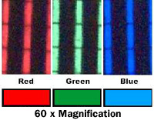
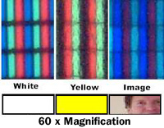
Working with color
Color pixels are combinations of red, blue, and green light
Each R G B element can take on 256 levels of brightness

Slide 57
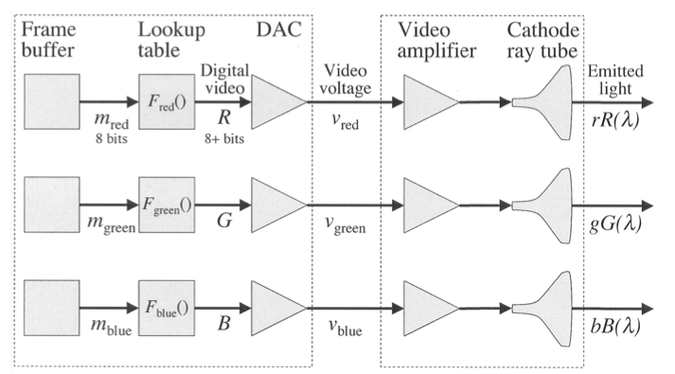
Working with color
Brainard et al., 2002

Slide 58
Working with color
the Color Lookup Table (CLUT) maps the values from your color indices to real voltage values use to light screen.
In standard cases, 0 is mapped to the lowest value, and 255 to the highest, such that [0 0 0] is black and [255 255 255] is white
However, this may not always be the case. You can use BlackIndex(wPtr) and WhiteIndex(wPtr) to return the index that corresponds to black and white on your system
If you want to get fancy, you can specify your own CLUT

Slide 59
Working with color
Specify colors using a vector of 3 integers
myColor = [ x, y, z]
Examples:
red= [ 255,0,0]
aqua = [0,200,255]

Slide 60
Working with color
Grayscale colors can be specified using a single number:
black = 0;
white = 255;
gray = 150;
black = 0 is equivalent to black = [0 0 0]

Slide 61

Drawing in PTB
PTB uses OpenGL for drawing to the screen.
Open GL is the "Open Graphics Library". It is cross-platform software for specifying how to draw 2D and 3D graphics using the GPU to achieve hardware-accelerated processing.
PTB has its own functions for drawing that access lower-level OpenGL functions. But if you want to access actual OpenGL commands you can do that too, or use OpenGL objects created in a program like Blender.

Slide 62
Drawing functions
Screen('DrawLine', windowPtr [,color], fromH, fromV, toH, toV [,penWidth]);
Screen('DrawArc',windowPtr,[color],[rect],startAngle,arcAngle)
Screen('FrameArc',windowPtr,[color],[rect],startAngle,arcAngle[,penWidth] [,penHeight] [,penMode])
Screen('FillArc',windowPtr,[color],[rect],startAngle,arcAngle)
Screen('FillRect', windowPtr [,color] [,rect] );
Screen('FrameRect', windowPtr [,color] [,rect] [,penWidth]);
Screen('FillOval', windowPtr [,color] [,rect] [,perfectUpToMaxDiameter]);
Screen('FrameOval', windowPtr [,color] [,rect] [,penWidth] [,penHeight] [,penMode]);
Screen('FramePoly', windowPtr [,color], pointList [,penWidth]);
Screen('FillPoly', windowPtr [,color], pointList [, isConvex]);
Screen('DrawDots', windowPtr, xy [,size] [,color] [,center] [,dot_type]);
Screen('DrawLines', windowPtr, xy [,width] [,colors] [,center] [,smooth]);

Slide 63
Screen coordinate system
(0,0)
y
(xMax,yMax)

Slide 64
OpenWindow expanded
[windowPtr, rect] = Screen('OpenWindow',whichWindow,bgColor,rect)
Set the screen's background color (default is white)
Define a rect for the screen to appear in (default is to take up the whole physical screen) Note: timing may suffer if you are not using full screen

Slide 65
Drawing simple shapes
>> Screen FillRect?
Usage:
Screen('FillRect', windowPtr [,color] [,rect] )
Fill "rect". "color" is the clut index (scalar or [r g b] triplet or [r g b a]
quadruple) that you want to poke into each pixel; default produces white with
the standard CLUT for this window's pixelSize. Default "rect" is entire window,
so you can use this function to clear the window. Please note that clearing the
entire window will set the background color of the window to the clear color,
ie., future Screen('Flip') commands will clear to the new background clear color
specified in Screen('FillRect').
Instead of filling one rectangle, you can also specify a list of multiple
rectangles to be filled - this is much faster when you need to draw many
rectangles per frame. To fill n rectangles, provide "rect" as a 4 rows by n
columns matrix, each column specifying one rectangle, e.g., rect(1,5)=left
border of 5th rectange, rect(2,5)=top border of 5th rectangle, rect(3,5)=right
border of 5th rectangle, rect(4,5)=bottom border of 5th rectangle. If the
rectangles should have different colors, then provide "color" as a 3 or 4 row by
n column matrix, the i'th column specifiying the color of the i'th rectangle.
See also: FrameRect

Slide 66
Drawing simple shapes
Screen('FillRect', wPtr, color, rect);
Define the rectangle(s) to fill in. If you leave this blank, the whole screen will be filled, and the background color will be set to that color (when you Flip the screen, the buffer will clear to this color)

Slide 67
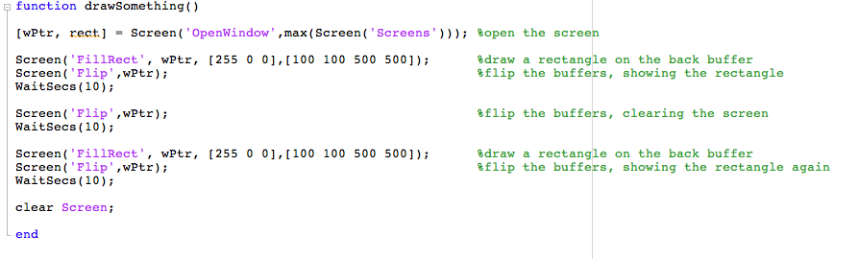

Slide 68
Drawing multiple rects
>> rectOne = [100 100 250 400];
>> rectTwo = [250 400 300 450];
>> bothRects = [rectOne', rectTwo']
bothRects =
100 250
100 400
250 300
400 450
>> Screen('FillRect',w,[0 255 0],bothRects);
>> Screen('Flip',w)

Slide 69
Centering
Problem: Draw a 100 by 100 square exactly centered in the screen
First step: find the center of the screen

Slide 70
Centering
>> [wPtr,rect] = Screen('OpenWindow',1)
wPtr =
11
rect =
0 0 1680 1050
>> screenWidth = rect(3);
>> screenHeight = rect(4);
>> screenCenterX = screenWidth/2;
>> screenCenterY = screenHeight/2;
>>
>> myRectWidth = 100;
>> myRectHeight = 100;
>>
>> myRectLeft = screenCenterX – myRectWidth/2;
>> myRectTop = screenCenterY – myRectHeight/2;
>> myRectRight = myRectLeft + myRectWidth;
>> myRectBottom = myRectTop + myRectHeight;
>> myRect = [myRectLeft, myRectTop, myRectRight, myRectLeft];
>>
>> Screen('FillRect',wPtr,[0 0 255],myRect);
>> Screen('Flip',wPtr);

Slide 71
Centering
(screenCenterX – rectWidth/2, screenCenterY – rectHeight/2)
(screenCenterX,screenCenterY)
(rectLeft + rectWidth, rectTop + rectHeight)

Slide 72
Drawing
Screen('FrameRect', wPtr, color, rect, penWidth);
Just like FillRect, but the rectangle is not filled in. Change penWidth to change the thickness of the lines

Slide 73
Drawing circles
Screen('FillOval', wPtr, color, rect);

Slide 74
Drawing circles
>> Screen('FillRect',wPtr,[0 0 255],myRect)
>> Screen('FillOval',wPtr,[255 0 0 ],myRect)
>> Screen('Flip',wPtr);
Note drawing order! As we add to the screen, new shapes are added on top of old ones.

Slide 75
Alpha blending
>> Screen BlendFunction?
>> Screen('BlendFunction',wPtr,GL_SRC_ALPHA,GL_ONE_MINUS_SRC_ALPHA);
>> Screen('BlendFunction',wPtr,GL_ONE,GL_ZERO);
ENABLE BLENDING
DISABLE BLENDING

Slide 76
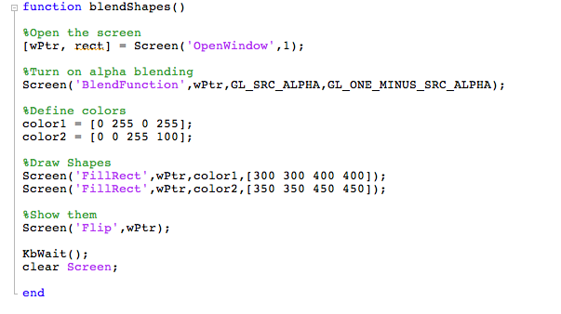
Alpha blending

Slide 77
Drawing lines
Screen('DrawLine', wPtr, color, fromH, fromV, toH, toV, penWidth);
(fromH, fromV)
(toH, toV)

Slide 78
Using DrawDots
Alternate method for drawing several shapes at once. Even though it is called DrawDots, it will draw squares as well as circles.
Screen('DrawDots', windowPtr, xy [,size] [,color] [,center] [,dot_type]);
Matrix containing coordinates of dot centers. Two rows, x and y. Each column is another dot.
Define center coordinates
0 (default) = squares
1 = circles
2 = circles with high quality anti-aliasing
Can either be a single value, or a vector of values, one per dot
Single color vector, or matrix with three rows (r,g,b)

Slide 79
>> [wPtr, rect] = Screen('OpenWindow',1);
>> xCenter = rect(3)/2;
>> yCenter = rect(4)/2;
>>
>> colors = [255 0 0; 0 255 0; 0 0 255]
colors =
255 0 0
0 255 0
0 0 255
>> locations = [-100 0 100; 0 0 0]
locations =
-100 0 100
0 0 0
>> sizes = [30 40 50];
>> Screen('DrawDots',wPtr,locations, sizes, colors, [xCenter,yCenter], 1);
>> Screen('Flip',wPtr);

Slide 80
Using DrawLines
Screen('DrawLines', windowPtr, xy [,width] [,colors] [,center] [,smooth]);
Matrix containing coordinates. Two rows (x and y). Each pair of columns (start and end) specifies a line.
0 (default) = no smoothing
1 = smoothing
2 = high quality smoothing
NOTE: smoothing requires blending to be on
Either a single color, or one color per point in xy. Three rows (r,g,b).

Slide 81
>> lines = [-300 300 -300 300; -50 -50 50 50]
lines =
-300 300 -300 300
-50 -50 50 50
>> colors = [255 0 0 255; 0 0 0 0 ; 0 255 255 0]
colors =
255 0 0 255
0 0 0 0
0 255 255 0
>> Screen('DrawLines',wPtr,lines,10,colors,[xCenter,yCenter],0)
>> Screen('Flip',wPtr)

Slide 82
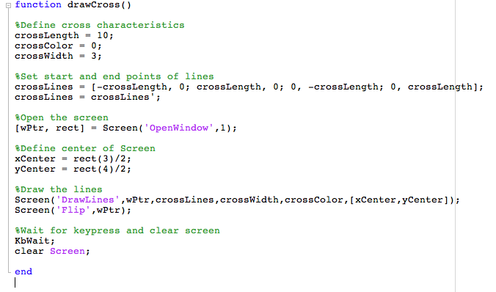
Drawing a fixation cross

Slide 83
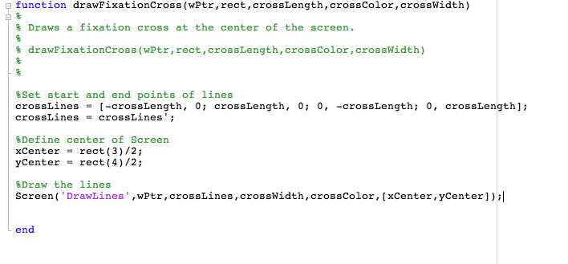
Drawing a fixation cross

Slide 84
Drawing a fixation cross
>> crossLength = 10;
>> crossWidth = 10;
>> crossColor = 0;
>> [wPtr, rect] = Screen('OpenWindow',1);
>> drawFixationCross(wPtr,rect,crossLength,crossColor,crossWidth);
>> fixationTime = Screen('Flip',wPtr);

Slide 85
Animation
Create a loop where something changes each time through the loop

Slide 86
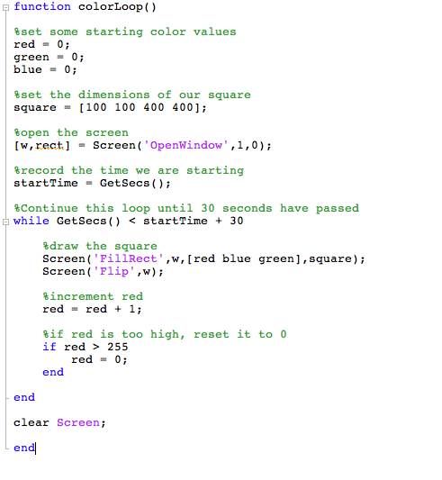

Slide 87
Drawing text
Two steps to drawing text:
1. Set up all the properties of the text we want to draw (font, size, style) using separate commands
2. Draw the text using DrawText

Slide 88
Drawing Text
Screen('TextSize',wPtr,size);
Screen('TextFont',wPtr,fontString);
Screen('TextStyle',wPtr,style);
0 = normal
1 = bold
2 = italic
4 = underline
8 = outline
32 = condense
64 = extend

Slide 89
Drawing Text
Screen('DrawText',wPtr,text,x,y,color)

Slide 90
Drawing Text
>> [wPtr, rect] = Screen('OpenWindow',1);
>> Screen('TextFont',wPtr,'Helvetica');
>> Screen('TextSize',wPtr,48);
>> Screen('DrawText','Hello there',100,100,[200 0 0]);

Slide 91
Drawing Text
Sometimes, to position text, we need to know its size in pixels:
rect = Screen('TextBounds',wPtr,textString);

Slide 92
Drawing Formatted Text
DrawFormattedText(wPtr,textString,sx,sy,color,wrapat,flipHorizontal,flipVertical, vSpacing, rightoleft, winRect)
Advantages over DrawText:
Helpful for splitting text into multiple lines. Can include newline characters in the text string (\n).
Can do automatic centering if you set sx to "center" or right justify if you set to "right"

Slide 93
Drawing Text
>> [wPtr, rect] = Screen('OpenWindow',1);
>> myText = 'The experiment\nIs about to begin';
>> DrawFormattedText(wPtr,myText,'center',rect(4)/2,0);

Slide 94
Displaying pictures
Steps to displaying a picture:
1. Use imread() to read the image into a matrix of numbers
2. Use MakeTexture to create an OpenGL texture using that matrix
3. Use DrawTexture to draw the texture to the screen

Slide 95
Displaying images
>> faceData = imread('sadface.jpg');
>> size(faceData);
ans =
650 506 3
>> faceTexture = Screen('MakeTexture',wPtr,faceData);
>> Screen('DrawTexture',wPtr,faceTexture);
>> Screen('Flip',wPtr);

Slide 97
Assignment Week 3
Write a function called yourInitials_week3()
The function should take two inputs:
- An integer called speed
- An integer called radius
The function should:
- Draw a circle in the center of the screen with radius equal to radius. Wait for the user to press a key. The circle will then start moving diagonally towards the lower right hand corner of the screen. The speed at which it moves will be determined by speed: speed is actually the number of pixels that the circle will move each frame. In other words, increment both the x and y position of the circle by speed every frame.
- If the circle should "bounce" off the edge of the screen. That means that once it hits the bottom of the screen, it will start to move up instead of down, and when it hits the right side of the screen it will start to move left instead of right, etc.
- The color of the circle should randomly change whenever it hits a wall
- The circle will continue to bounce around the screen indefinitely

Slide 98
Final Exam
Full Experiment. Must:
Write the entire thing from scratch yourself
Take subject code and any relevant conditions as inputs
Present repetitive trials that involve at least 2 different conditions
Must present either visual or auditory stimuli (or both)
Must collect some kind of behavioral response where timing is recorded
Must write responses out to a log file
Please run your experiment plan by me as soon as possible. If you don't have something you are working on now, I will make something up for you.

